Slide 1
LeetCode Review
Reporter: Tony Yu

Slide 2
5 LeetCode Medium Question
Contain With Most Water
Letter Combinations of a Phone Number
Rotate List
Minimum Path Sum
Integer to Roman

Slide 3
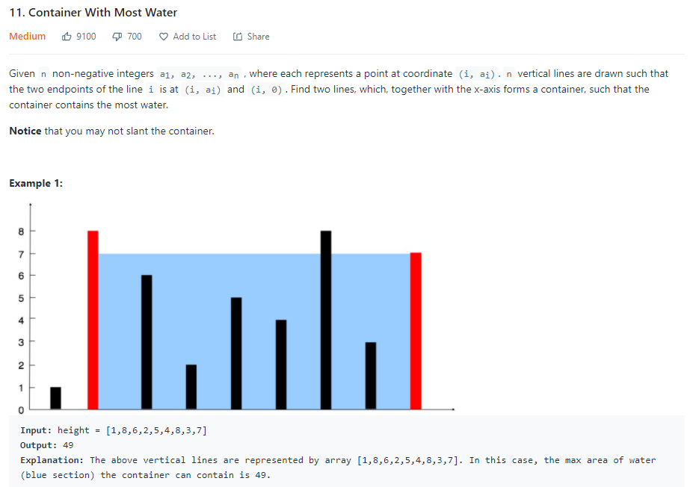
Container With Most Water

Slide 4
Thought
只移動矮的，因為高的移動只會讓面積變小
比較兩條線的高度，若左邊較小，則左邊的線往右移 left + 1，反之則右邊的線往左移 right — 1
用最矮的長度去相乘

Slide 5
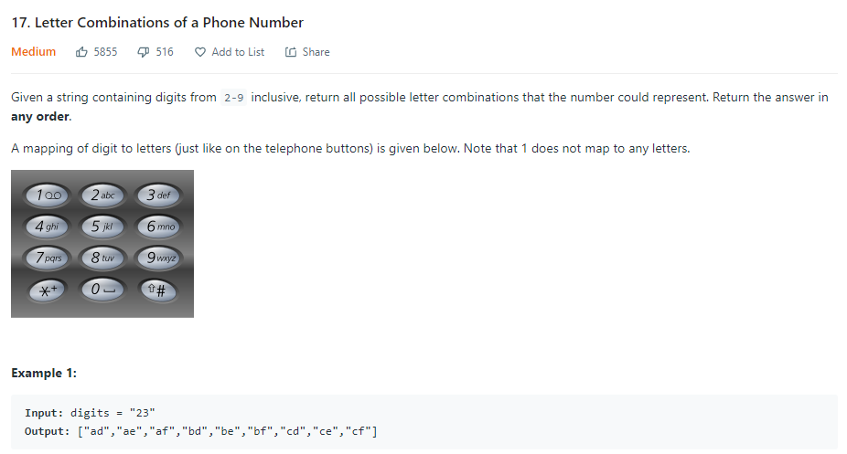
Letter Combinations of a Phone Number

Slide 6
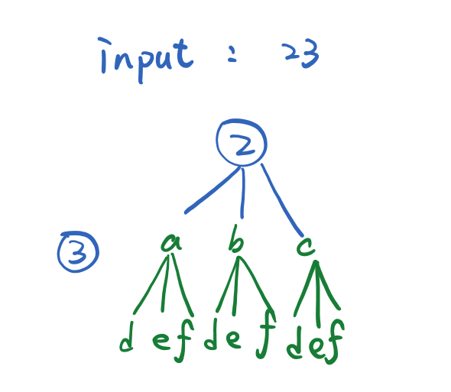
Thoughts

Slide 7
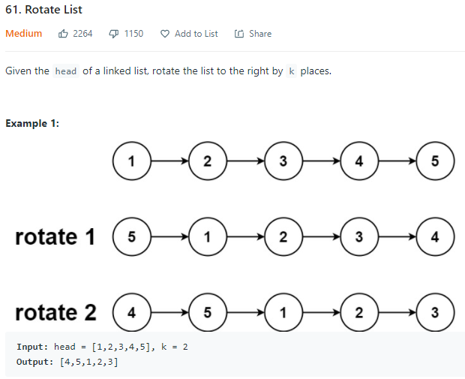
Rotate List

Slide 8
Thought
將list中每個node向右位移
把最後的node接回去list的開頭
K的數字代表會有幾個node往前移
K有可能會大於node數，當K%nodes=0時，代表又轉回來啦~

Slide 9
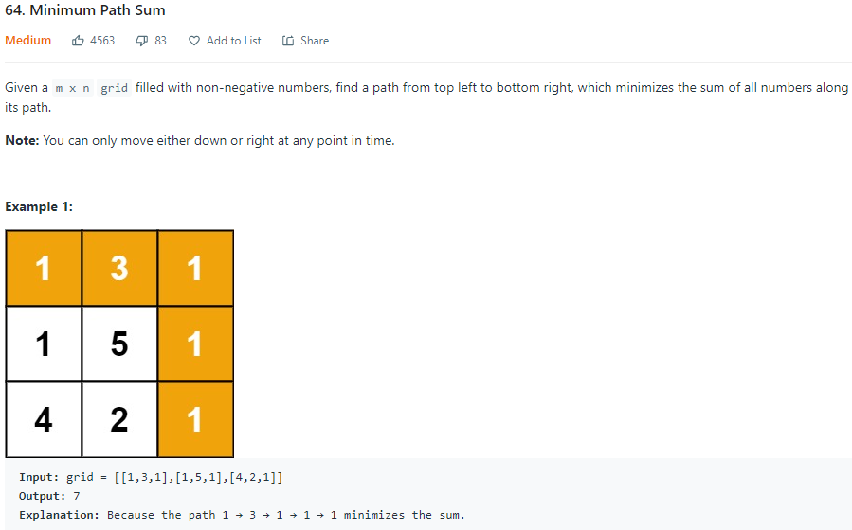
Minimum Path Sum

Slide 10
Thoughts
Dynamic Programming
背包問題
最短總和 = min(dp[i - 1][j] + dp[i][j - 1]) + grid[i][j];

Slide 11
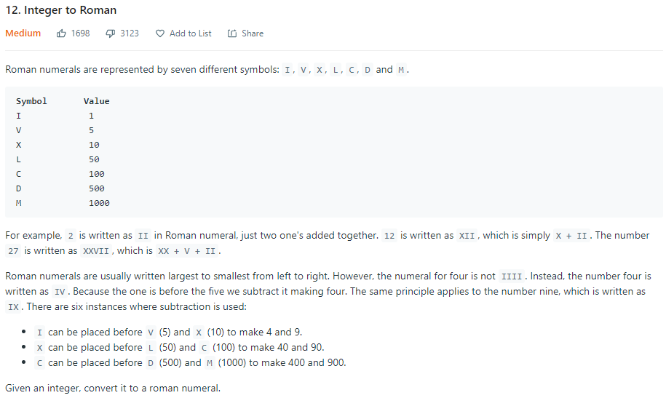
Integer to Roman

Slide 12
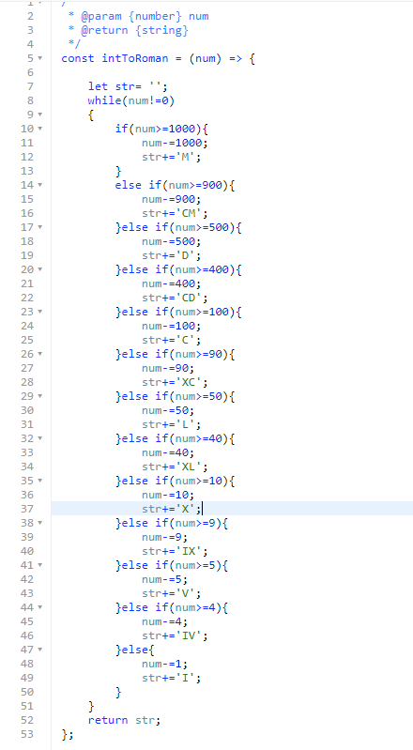
Thoughts

Slide 13
Thank You

